Slide 1

BAO PROJECT: CLASS SCHEDULING OPTIMIZATION GROUP 6
Wen Lay, Daniel
Chenaoui, Ismail

Slide 2
TABLE OF CONTENTS
01
02
INTRODUCTION
GA
03
04
ACO
CONCLUSION
Problem explanation, dataset, used algorithms, constraints.
Explain more deeply the GA used, elements, how it works, development and final results.
Explain more deeply the ACO used, elements, how it works, development and final results.
A conclusion about the project.

Slide 3
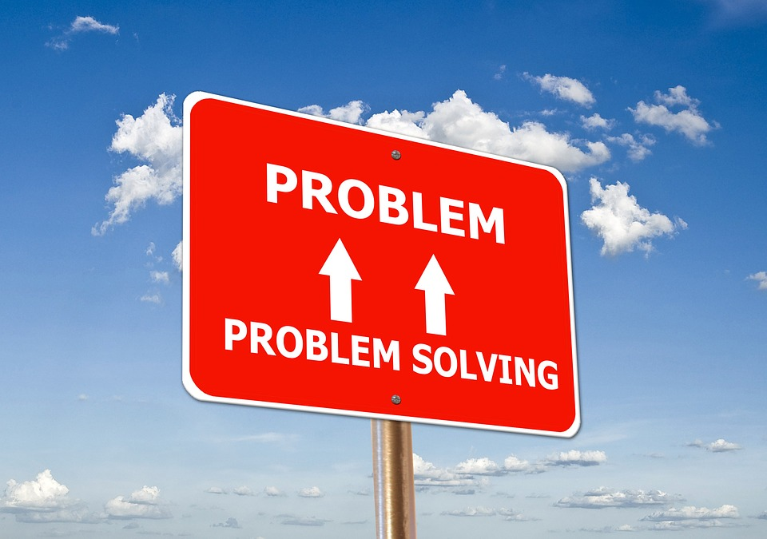
01
INTRODUCTION

Slide 4

WHAT DID WE CHANGE?
We changed the all project.
Requirements to be considered.
Optimization methodologies used.
Constraints to take into account.
Dataset.

Slide 5

Main Purpose
-Purpose.
-Mono-Objective.
-Solution obtained.

Slide 6

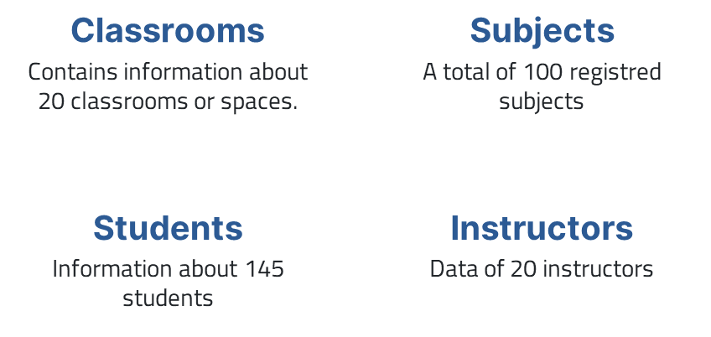
Previous Dataset

Slide 7
Updated Dataset
Customized Dataset.
-Dataset Constraints.
Courses (200).
Timeslots (25).
Rooms (30).
Instructors (80).
Students (500).
-Script Dataset Generator.
-Use of Dataset Generated.

Slide 8
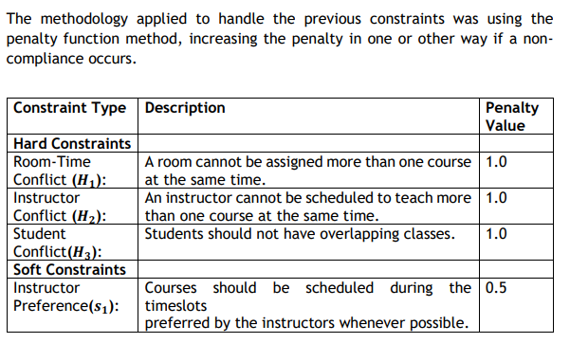
CONSTRAINTS

Slide 9
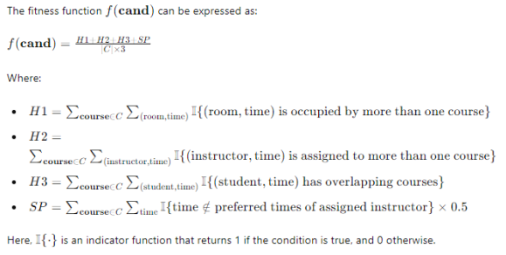
FITNESS FUNCTION

Slide 10


Optimization methodologies
Genetic Algorithm (GA)
Ant Colony Optimization (ACO)

Slide 11
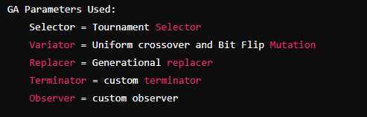
02
GENETIC ALGORITHM (GA)

Slide 12
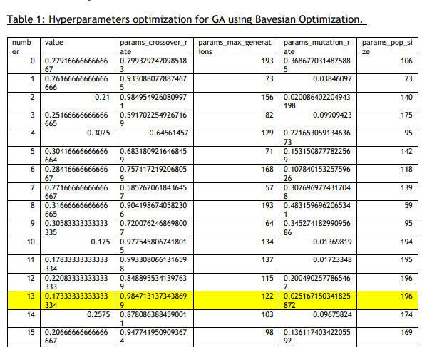
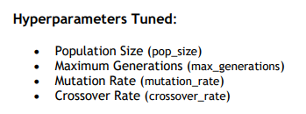
OPTIMIZATION HYPERPARAMETERS GA
First 15 repetitions
Total repetitions: 50

Slide 13
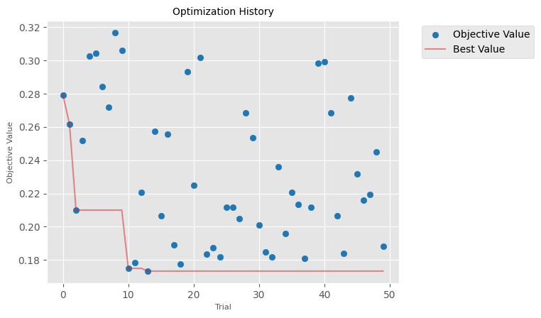
OPTIMIZATION HYPERPARAMETERS GA

Slide 14
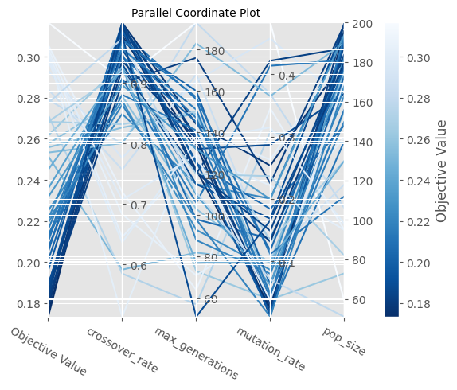
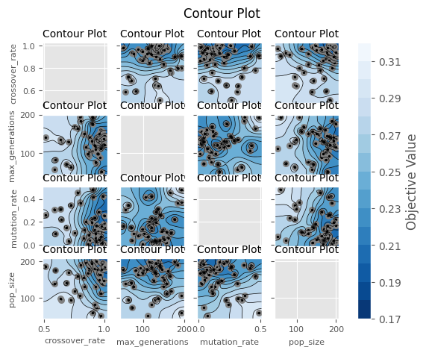
OPTIMIZATION HYPERPARAMETERS GA
Figure 3. Parallel Coordinate Plot of the relationships between the four hyperparameters for the GA.
Figure 4. Contour plot for GA.

Slide 15
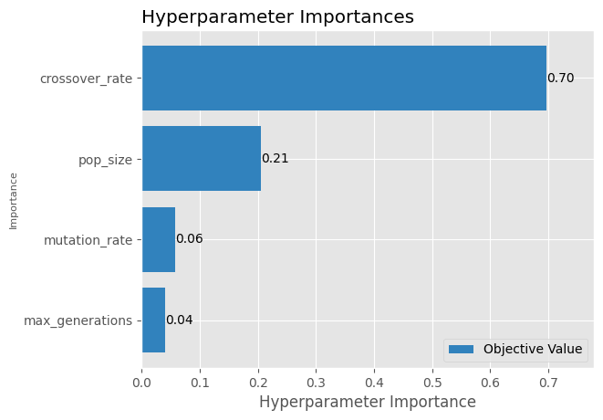
OPTIMIZATION HYPERPARAMETERS GA
In the Genetic Algorithm (GA), the importance of the hyperparameters was determined as follows:
• Crossover Rate: 70%
• Population Size: 21%
• Mutation Rate: 6%
• Maximum Generations: 4%
Figure 2. Hyperparameters importance by percentage.

Slide 16
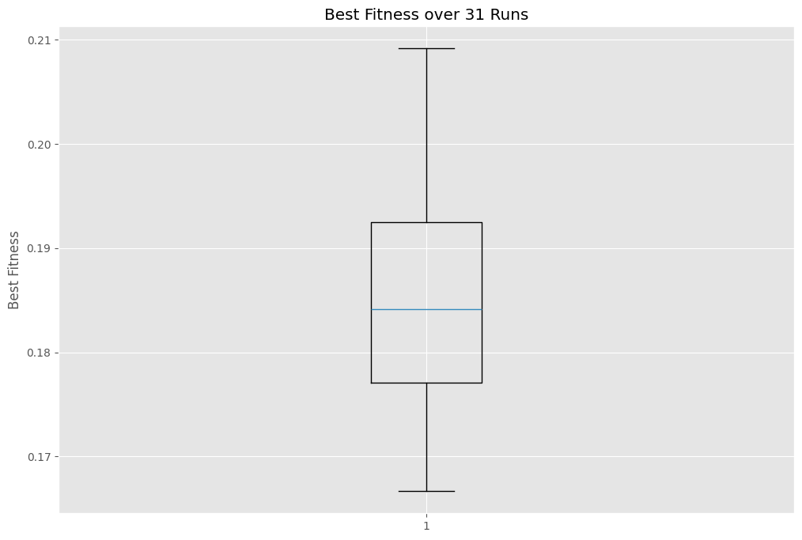
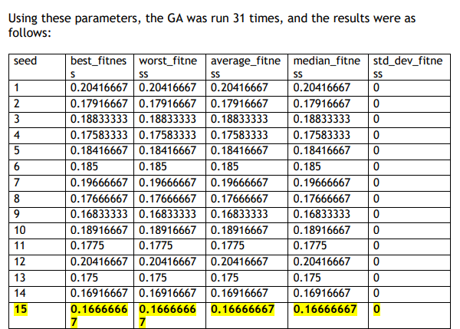
OPTIMIZATION HYPERPARAMETERS GA
Figure 5. Best Fitness over 31 runs.

Slide 17
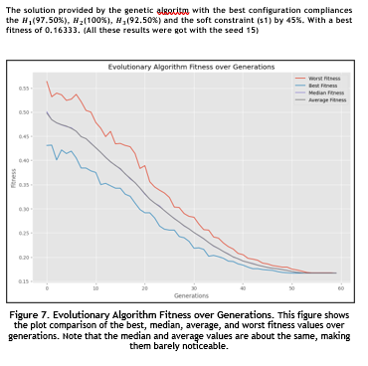
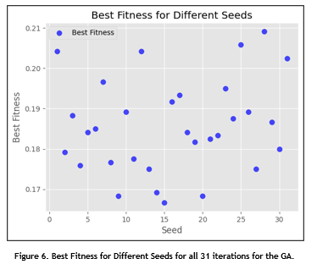
OPTIMIZATION HYPERPARAMETERS GA

Slide 18
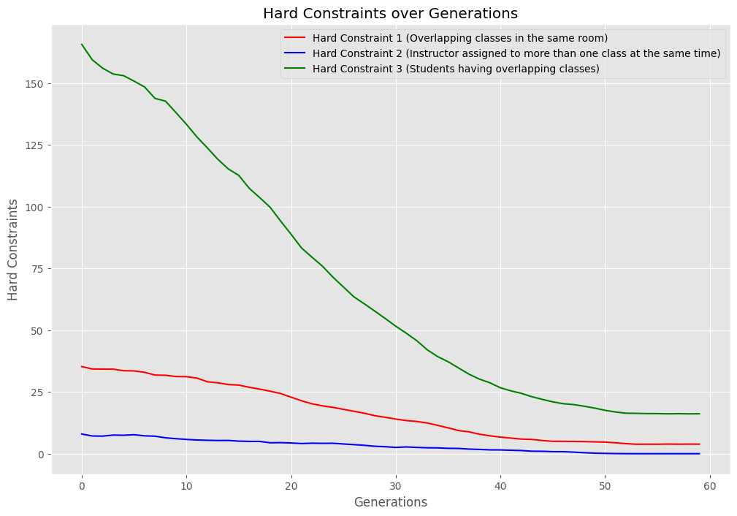
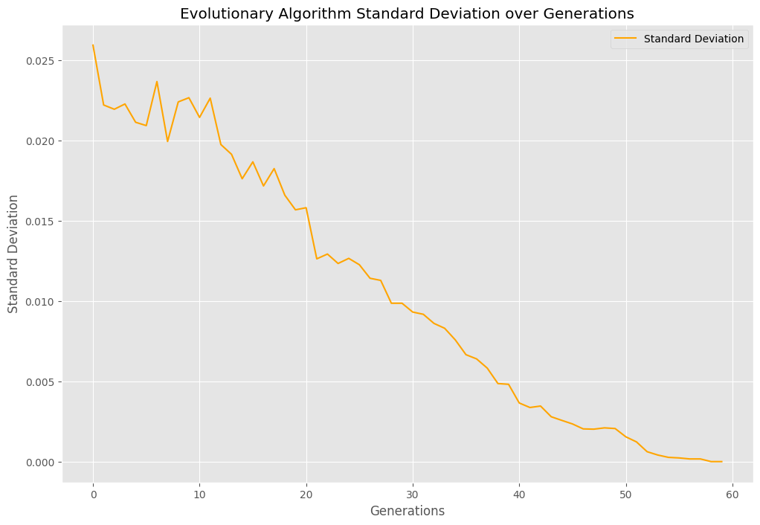
OPTIMIZATION HYPERPARAMETERS GA

Slide 19
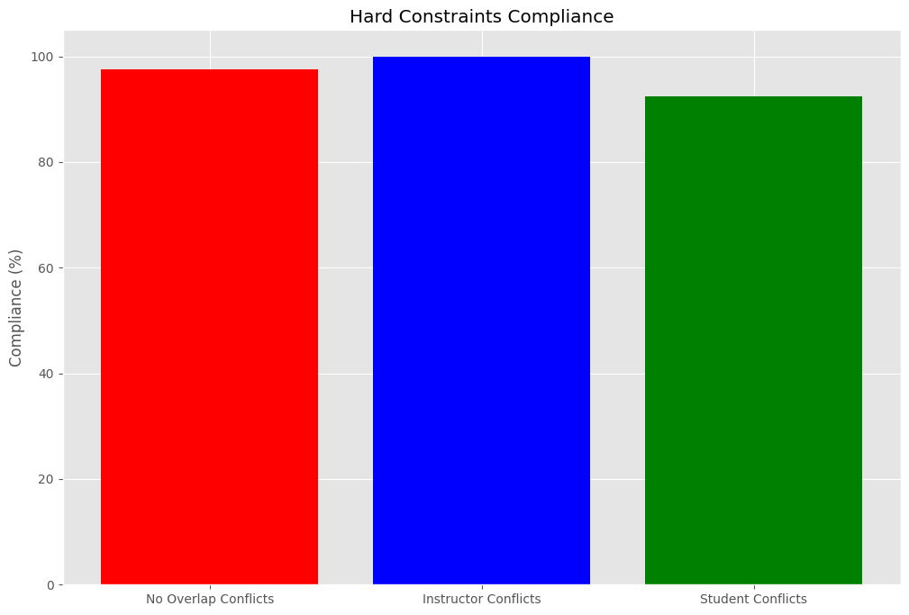
OPTIMIZATION HYPERPARAMETERS GA

Slide 20
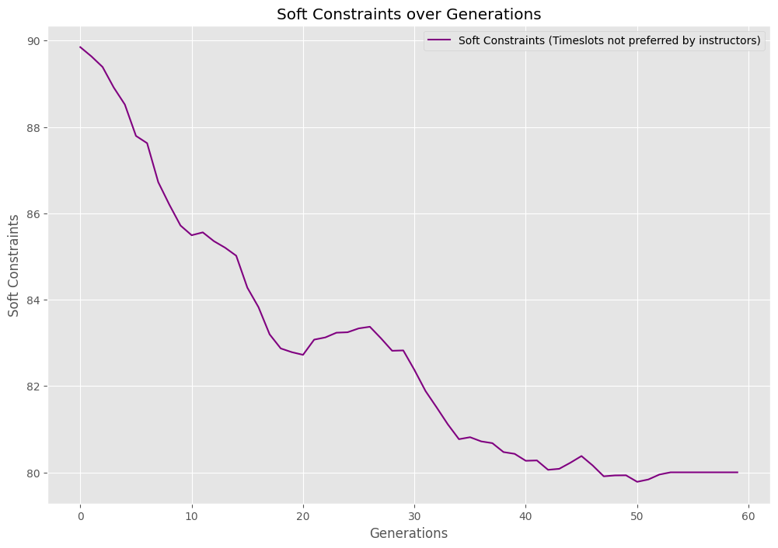
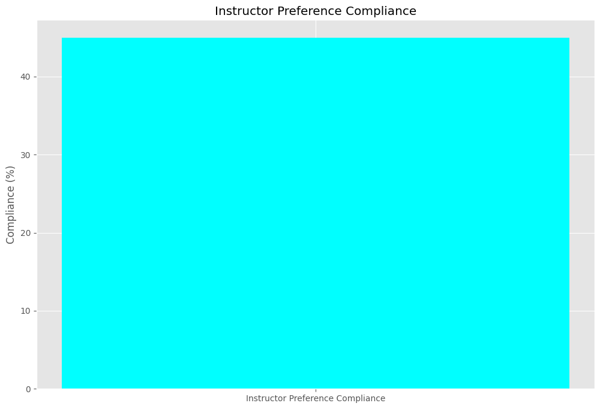
OPTIMIZATION HYPERPARAMETERS GA

Slide 21
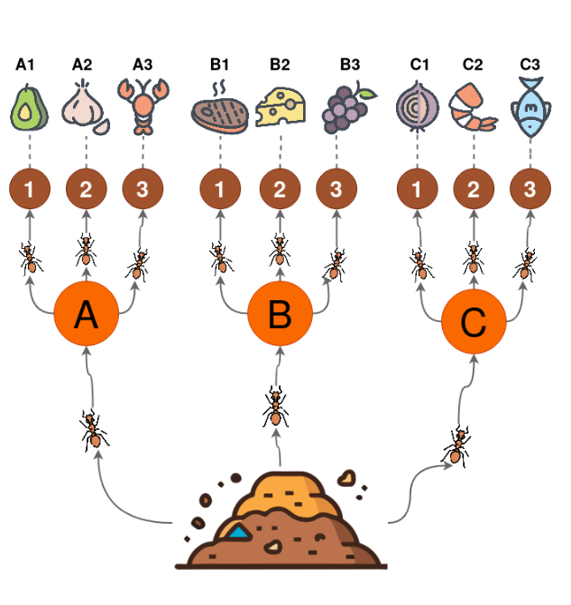
03
ANTS COLONY OPTIMIZATION (ACO)

Slide 22
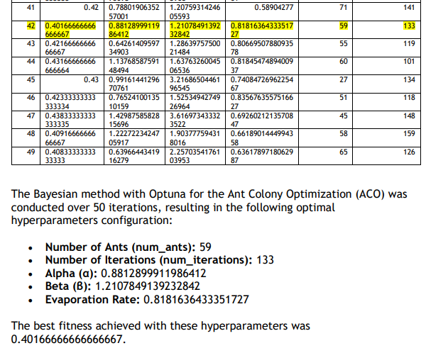
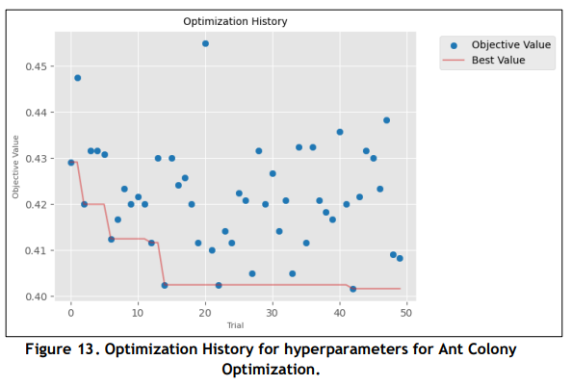

Slide 23
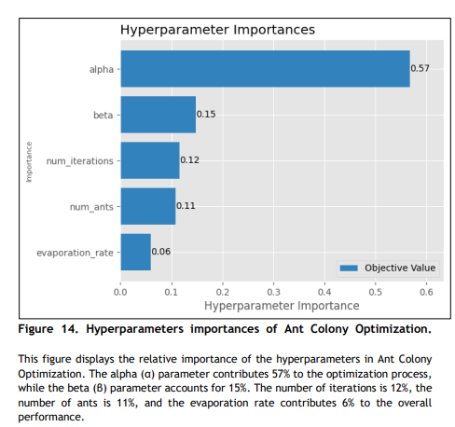
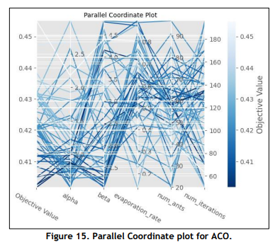
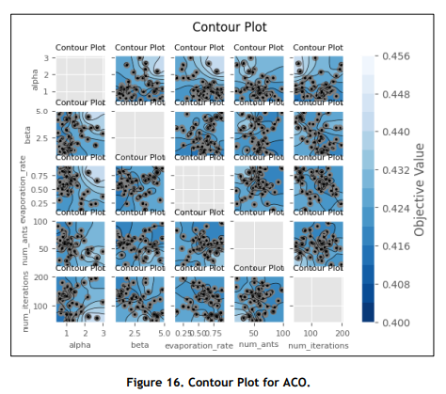

Slide 24
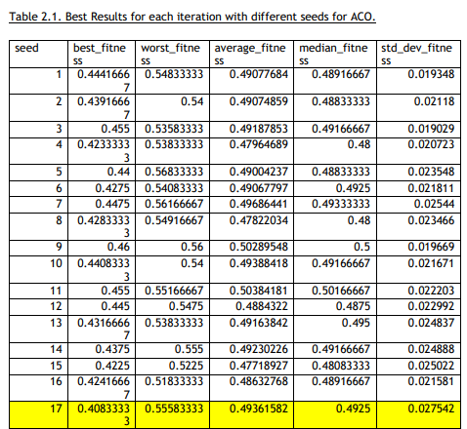
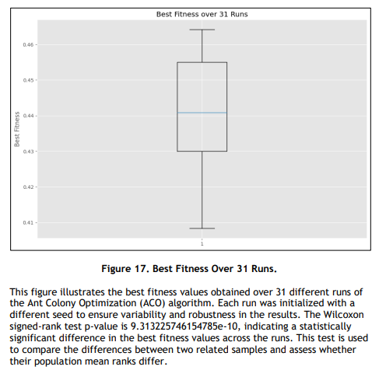

Slide 25
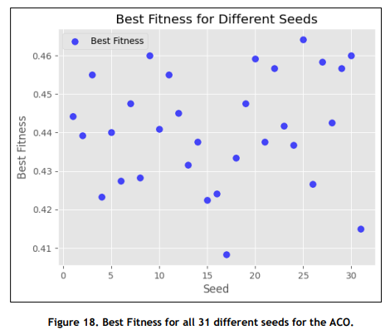
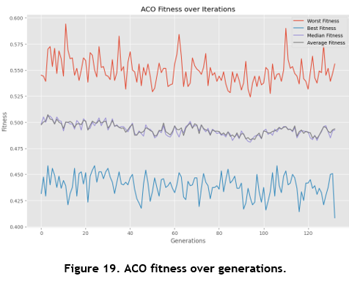

Slide 26
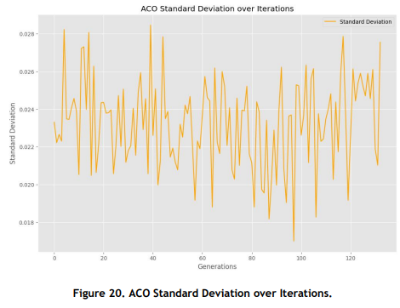

Slide 27
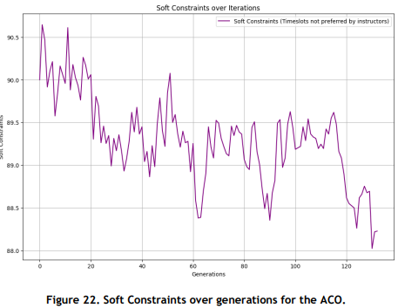
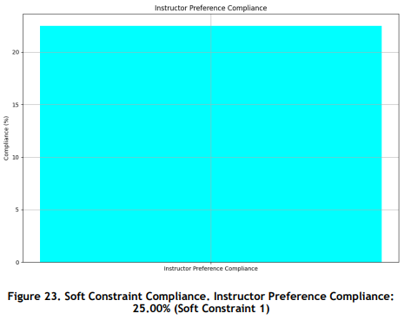

Slide 28
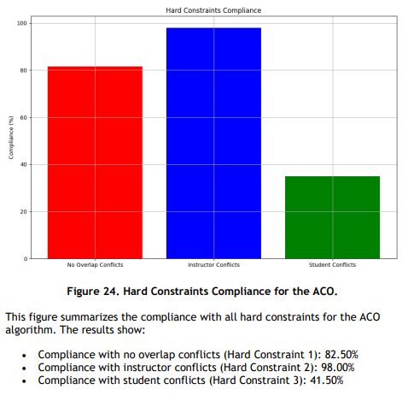
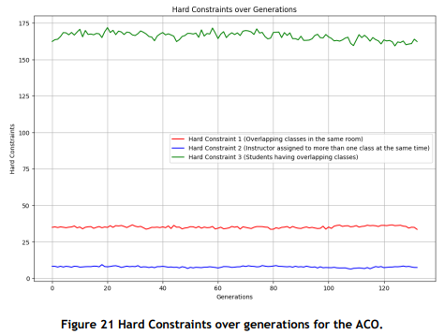

Slide 29
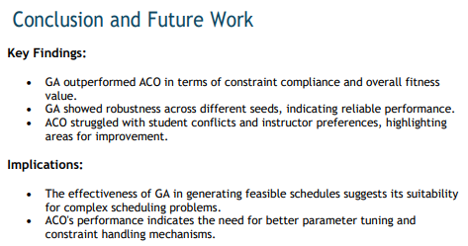
04
CONCLUSION

Slide 30

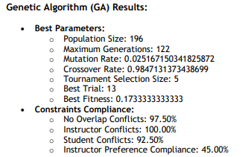
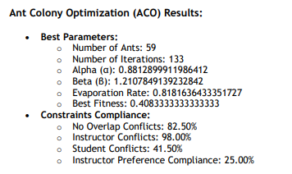
GA ACO

Slide 31
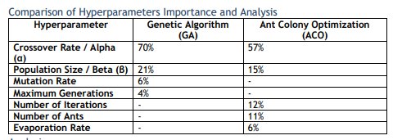
GA ACO

Slide 32
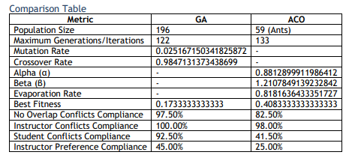
GA ACO

Slide 33
ACO GA
Strengths:
-Effective and intense search. -Find solutions in a shorter time. Weaknesses: -Takes time to be executed. -Less robust in diversity maintainability.
Strengths:
-High exploration capabilities. -Better scalability for larger problems.
Weaknesses: -Careful hiperparameters tunning.

Slide 34
Q&A
SESSION

Slide 35
THANK YOU!

Slide 36
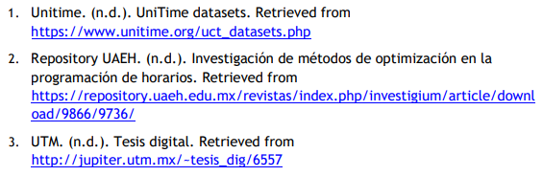
References
GitHub:
https://github.com/IsmailCh0901/BAO-Project-Extraordinaria-/blob/main/README.md
Google Collab : https://colab.research.google.com/drive/102iMOTvGnsjAuWj2xyNnBeRWupHt0LXd?usp=sharing#scrollTo=p7o7BQD8mT_S

